Slide 1


Slide 2

Exam Curriculum

Slide 3
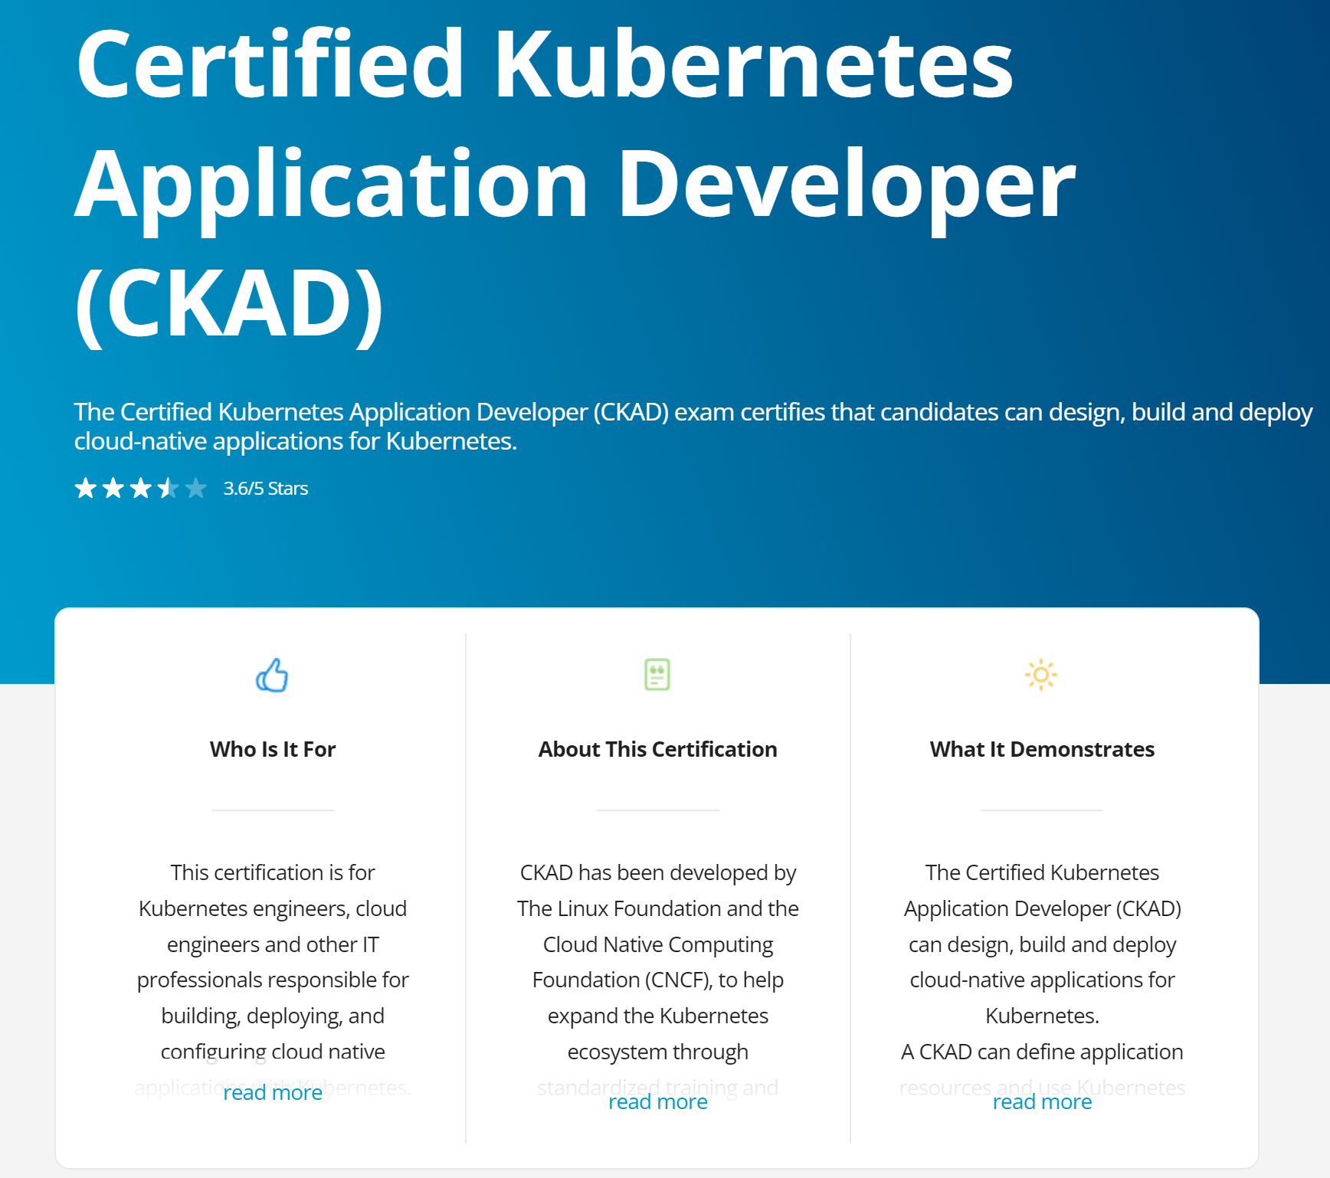
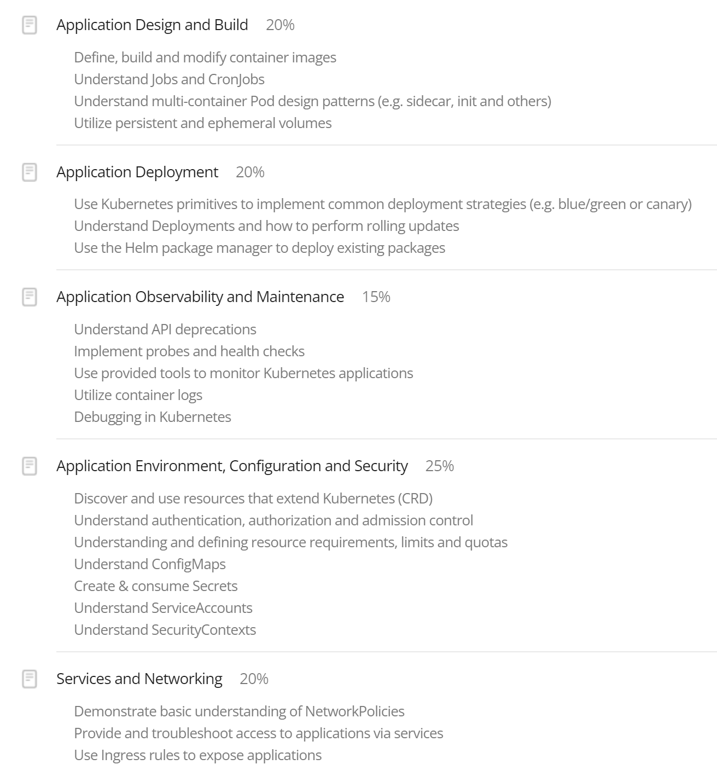
Exam Curriculum
2 hours time limit
66% minimum passing score
3 years validity
1 free retake
https://training.linuxfoundation.org/certification/certified-kubernetes-application-developer-ckad/

Slide 4

Resources

Slide 5

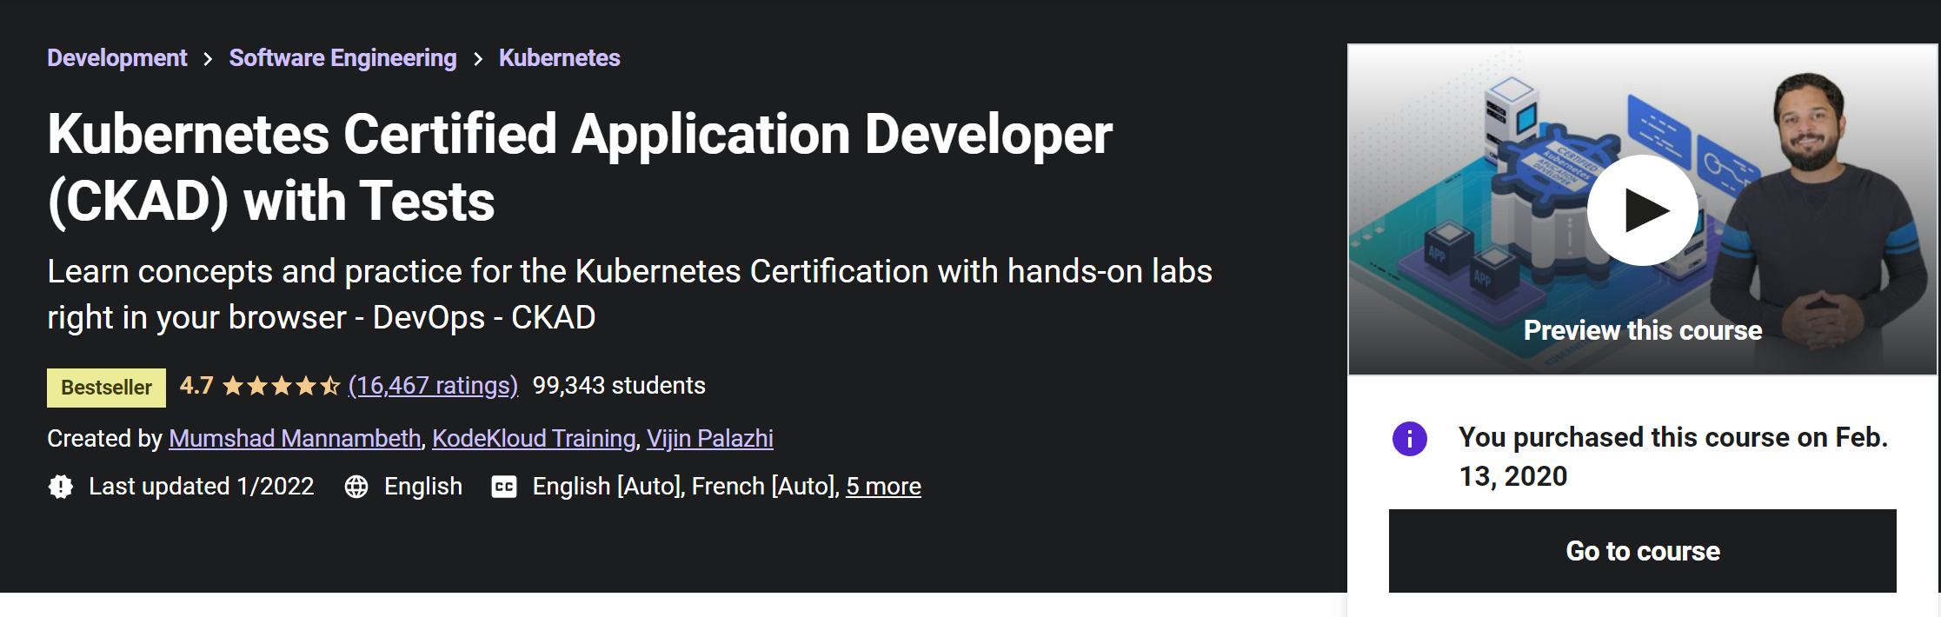
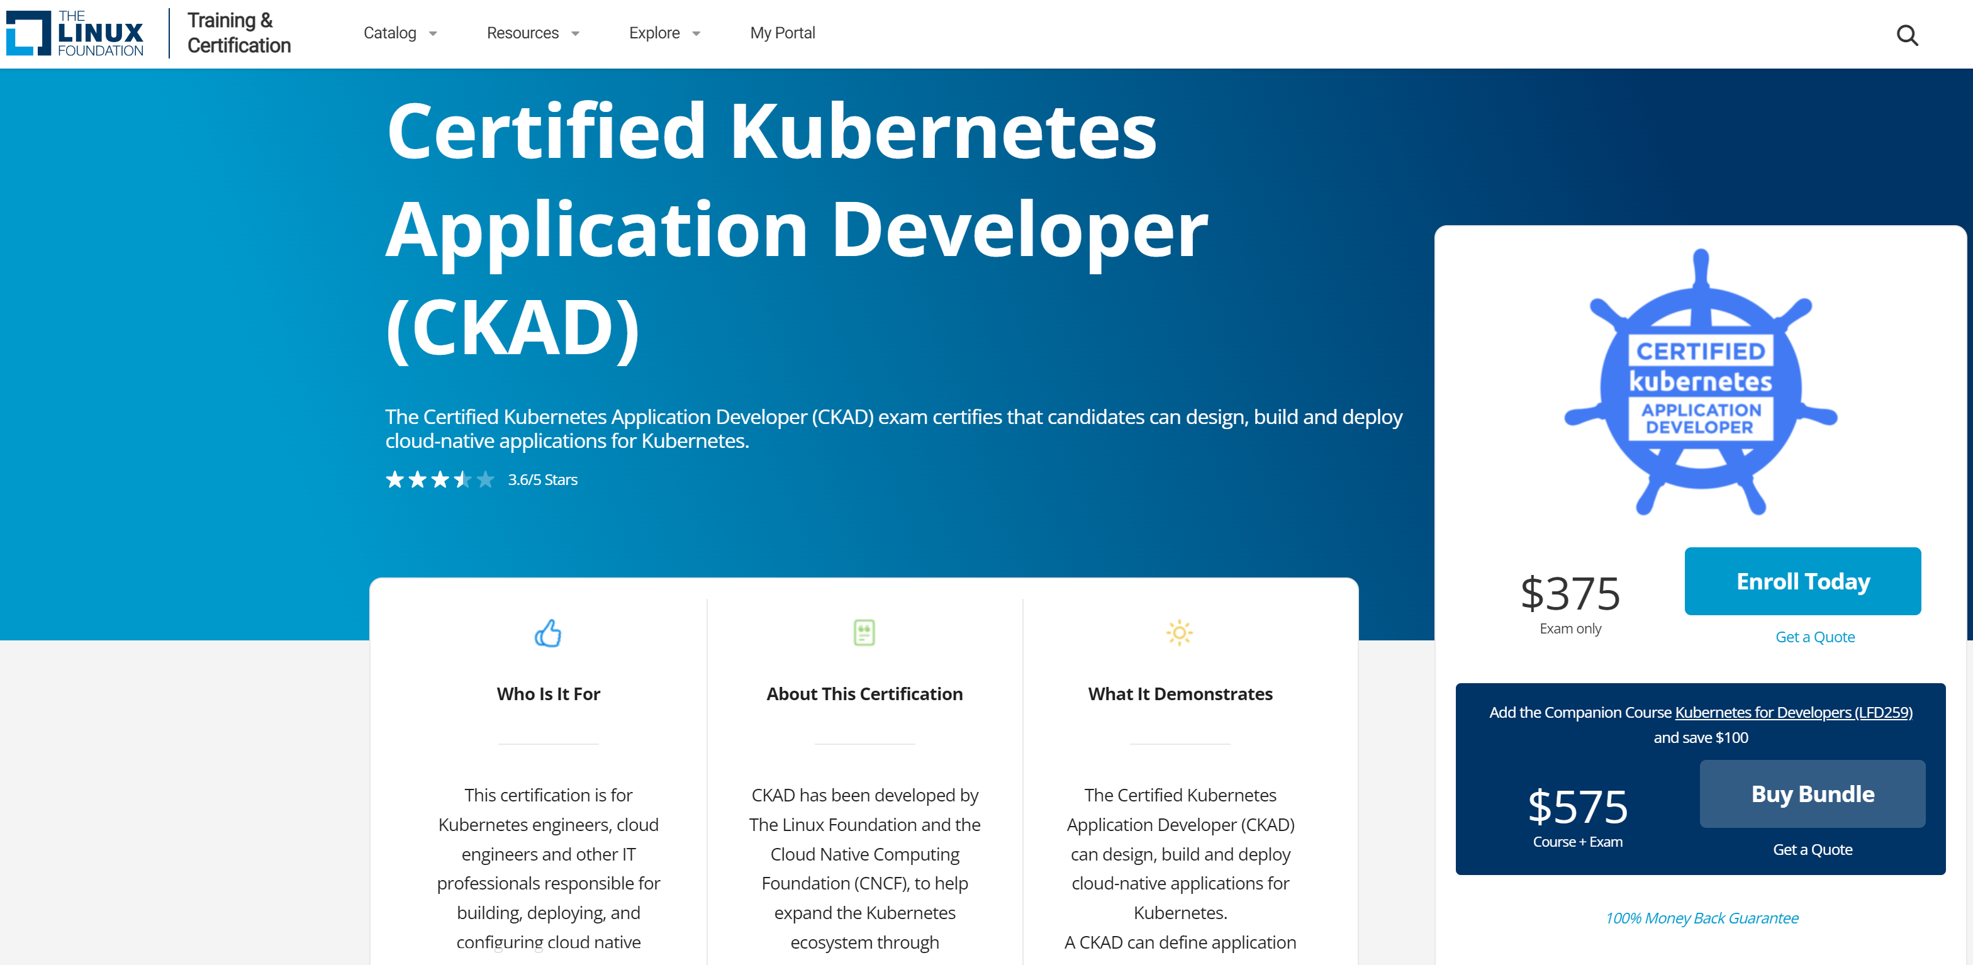

References
Kubernetes docs
Kubernetes.io/docs
Kubernetes.io/docs/tasks
Kubectl cheat sheet
eLearning
Udemy – CKAD with Practice Tests by Mumshad Mannambeth (beginner to intermediate)
Linux Foundation CKAD + Kubernetes fundamentals bundle (experienced professionals)

Slide 6


References
Github repos
CKAD exercises
CKAD resources
Nilesh Gule CKAD exam prep
Denny Zhang kubectl cheatsheet
Ahmet Alp Balkan Kubernetes network policy recipes
Blogs
Be fast with kubectl
CKAD practical challenge series
How to nail Kubernetes certification exams
Codefresh Kubernetes cheat sheet

Slide 7

Tips

Slide 8

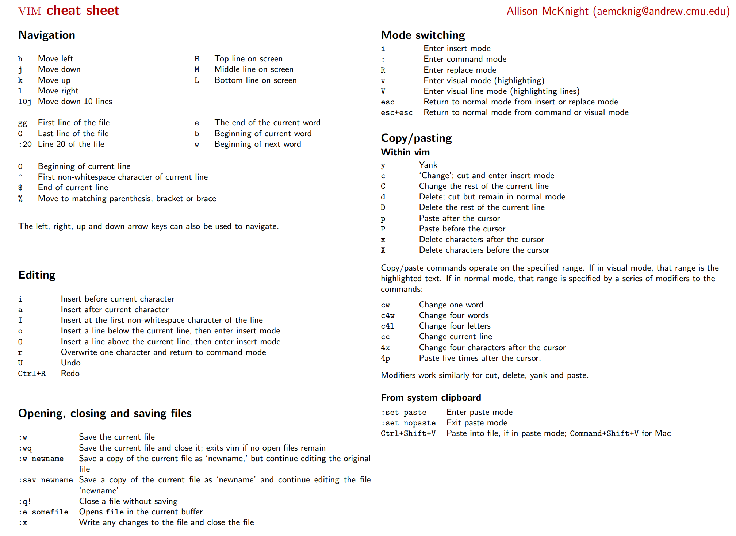
Tips
Before exam
Watch out for discounts (black Friday / Cyber Monday etc.)
Imperative commands
Be efficient with kubectl commands & options
Learn basic vi or nano editor commands
Practice, practice, practice
Bookmark specific links
Practice exam
Killer.sh CKAD simulator 36 hours access, 2 attempts
https://www.cs.cmu.edu/~15131/f17/topics/vim/vim-cheatsheet.pdf

Slide 9

Tips
During exam
Use external monitor (recommended), limit screen switching
External keyboard and mouse can also be used
Enable kubectl autocompletion
Create aliases (before starting test)
Update vimrc
Time management
Use imperative commands (huge time saver)
Use copy feature instead of typing
Use notepad feature to note things
Flag questions for review
Don’t spend too much time on single question (avg 5-6 mins)
Verify solution after completion of task

Slide 10
Aliases – bash profile
aliases
exports
export do=‘—dry-run=client –o yaml’
export fg=‘—force –grace-period=0’
alias cls=clear
alias kg=‘k get’
alias kgpo=‘kg po’
alias kgno=‘kg no’
alias kdes=‘k describe’
alias kaf=‘k apply –f’
alias kdf=‘k delete -f’

Slide 11
vimrc
Set tabstop=2
Set shiftwidth=2
Set expandtab

Slide 12
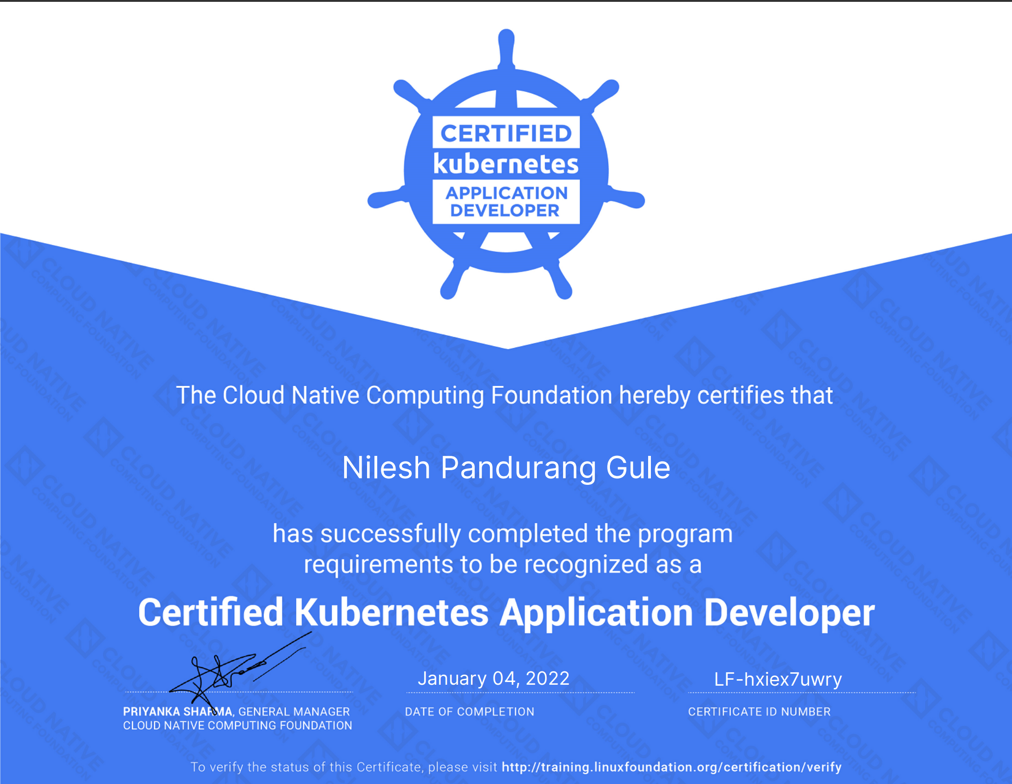

Slide 13


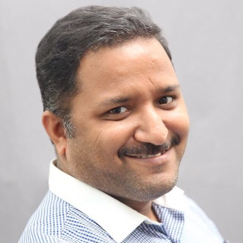



Nilesh Gule
https://bit.ly/youtube-nileshgule
Architect | Microsoft mvp
“Code with Passion and
Strive for Excellence”
NileshGule
nileshgule
@nileshgule
Nilesh Gule
www.handsonarchitect.com

